Slide 1
Read Me: This deck contains two sections. One for participants and a second for coaches.
Participant section
This top section is a Tech Scenario description for participants. The section will cover the technology introduction and high-level concepts about the challenges.
Audience: Participants at OpenHack
Coach only section
This section is a Tech Scenario description for coaches. The section will cover the technology, challenge goals, common pit falls, general guidance on solutions. This section is presented to coaches in the ‘know before you go’ call a few days before the OpenHack starts. This section is intended to be more in-depth than the participant section. Do not share the coach section with participants!
Audience: Coaches at OpenHack
Section 1
Section 2

Slide 2

Migrating Microsoft Workloads to Azure
#MSOpenHack

Slide 3
Migrating Microsoft Workloads to Azure
Technologies
Azure Migrate
Azure Database
Migration Service
Data Migration Assistant
Azure Active Directory
Azure Active Directory Connect (AAD Connect)
Azure Migrate
Azure Monitor/Log Analytics
Azure Networking
Azure Virtual Machines
Azure Storage
Azure DNS
Azure Traffic Manager
Azure Bastion
Azure Load Balancer
Azure Application Gateway
Modernize your applications by moving away from outdated, expensive legacy infrastructure: discover, assess, and migrate on-premises applications, infrastructure, and data.
Take it step-by-step: centrally plan and track the migration across multiple Microsoft and third-party open-source tools.
Increase resiliency and access to ongoing support for your legacy operating systems.

Slide 4
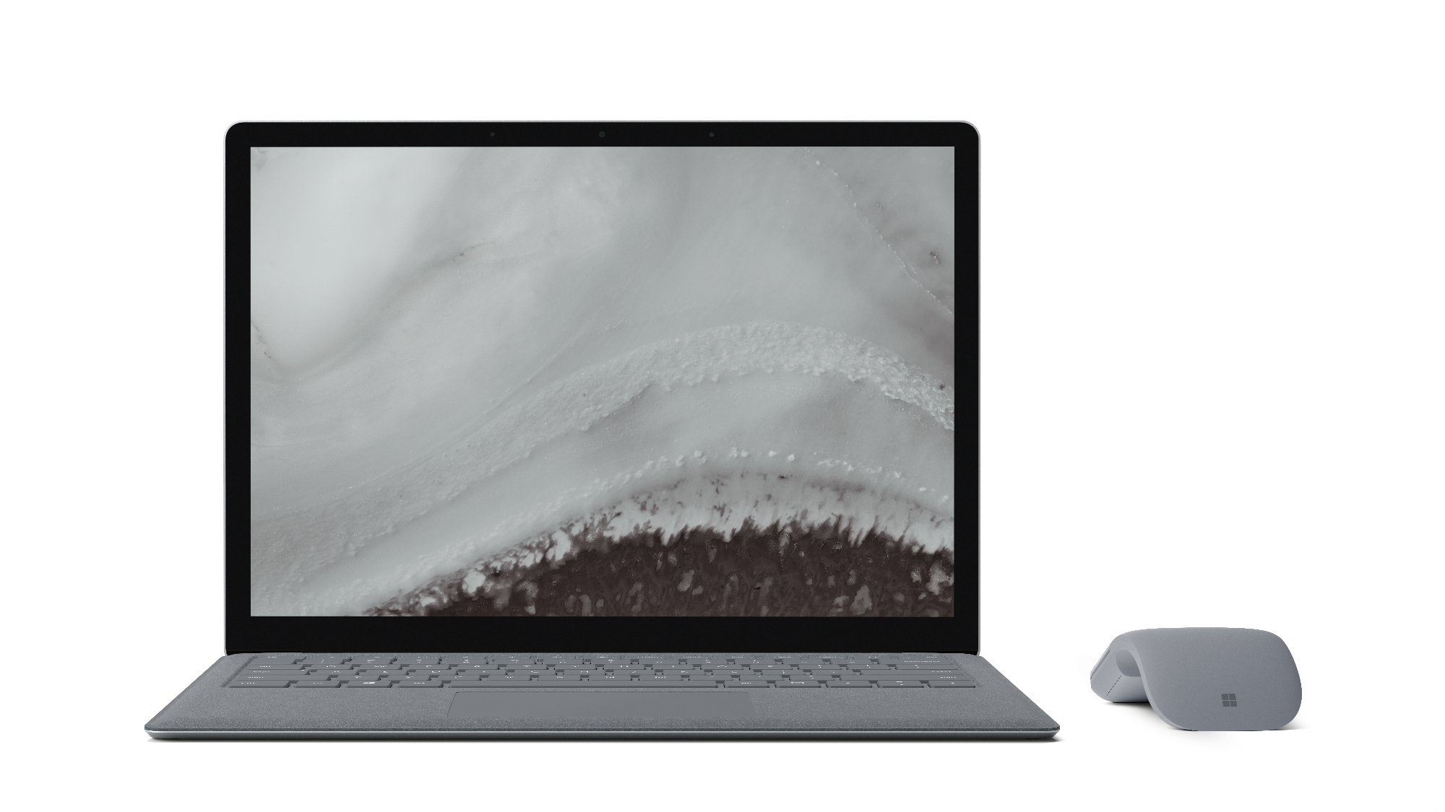
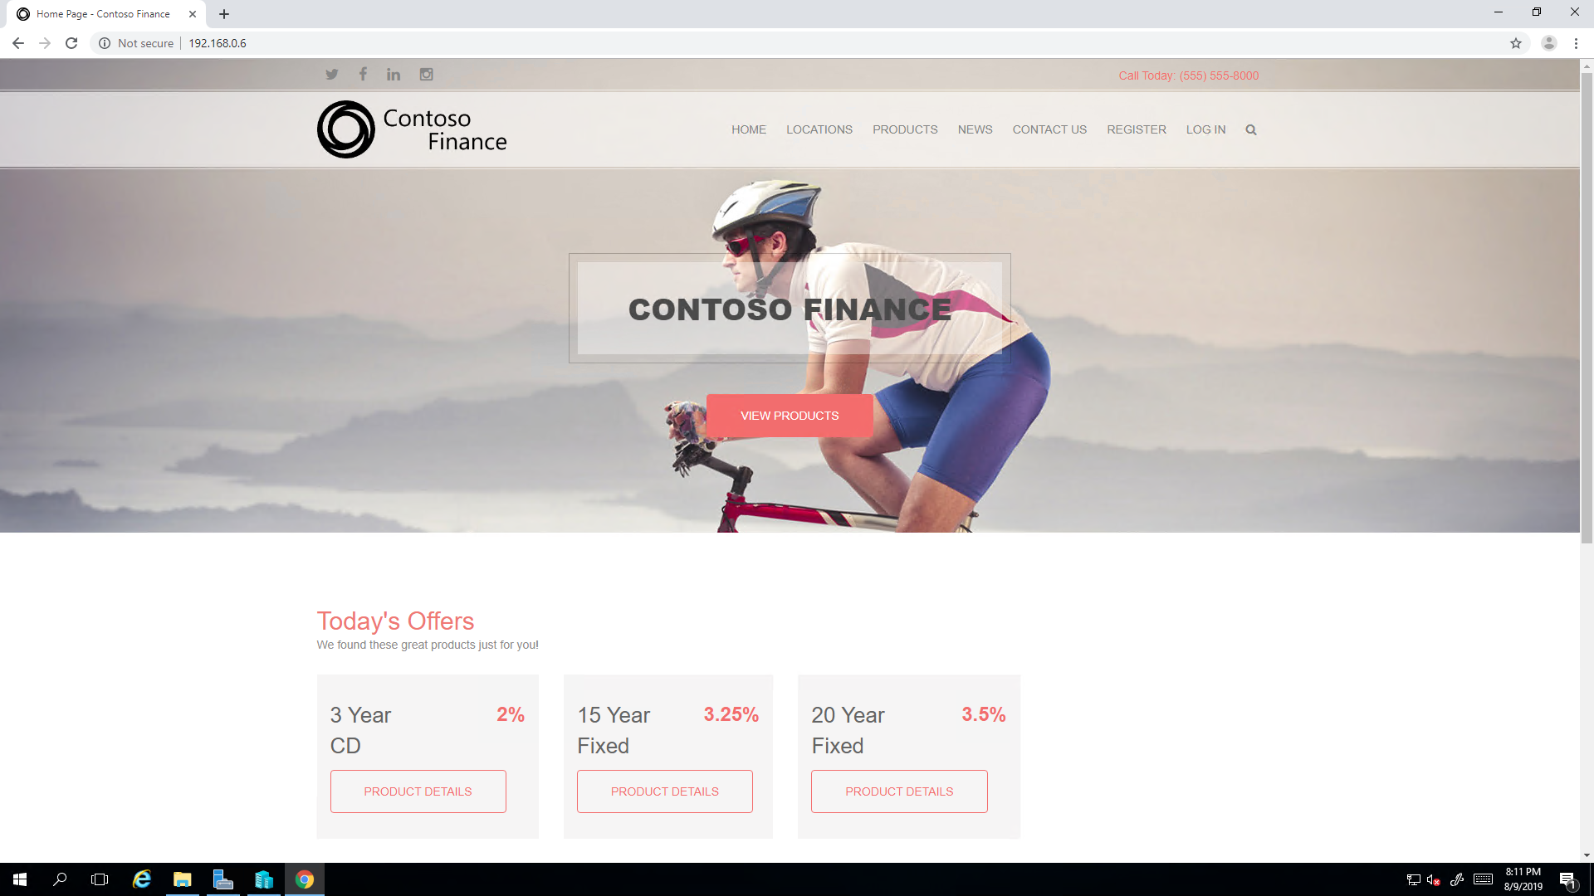
Scenario
Contoso mortgage company
Teams represent those responsible for migrating a series of multi-tier web applications from on-premises to Azure.
The web applications are used by customers (public facing) and internal employees (employee only).
The mission is to migrate to Azure by rehosting the existing applications and infrastructure with minimal downtime.
The success of teams depends on their ability to not only execute a challenge, but also provide enough reasoning for the choices they make.
Notes:
During this OpenHack, your team will assess, migrate, modernize, and optimize existing on-premises applications hosted in Windows Server 2008 R2 and Microsoft SQL Server 2008 R2 as they move to Microsoft Azure in a secure way. While each migration is different, by working through this OpenHack your team will gain the knowledge necessary to perform migrations of applications and VMs that use legacy Windows operating systems to Azure, modernize applications by transitioning from IaaS to PaaS services, and begin to gain insights into application performance and behaviors and how to secure organizational secrets.
Any resemblance to actual scenarios, issues, or pain points that you are facing is not purely coincidental. The definitions of the challenges that will be presented to you during this event are inspired by real life.

Slide 5
Migration
The challenges in this OpenHack are based on real world and validated scenarios from both the Microsoft field and customers
Know your stakeholders
Calculate your cost
Perform discovery
Plan your migration
Identity and governance
Determine a strategy to minimize downtime and accelerate migration
Test in isolation
Select the right tools
Transform IaaS to PaaS with minimal downtime
Improve with on-demand resource availability
Implement rich security
Data protection
Monitor and triage

Slide 6
Feedback
Goal-Oriented – It states what is trying to be accomplished by the user
Specific – Gives details about the scenario, observations, and/or challenges faced by the user
Actionable – Provide necessary clarifying information to enable a decision

Slide 7

Let’s get started!
aka.ms/OHPortal
Login with the credentials supplied to your team.
Notes:
To get started, visit the OpenHack portal:

Slide 8
Migrating Microsoft Workloads to Azure
Challenge walkthrough for coaches

Slide 9
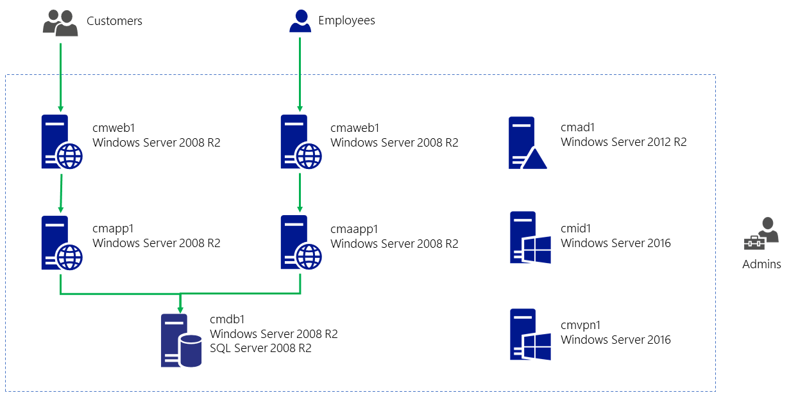
Architecture – Hyper-V
1 Hyper-V host
8 guests
2 web applications
1 shared database instance
1 unused server
1 unconfigured server

Slide 10
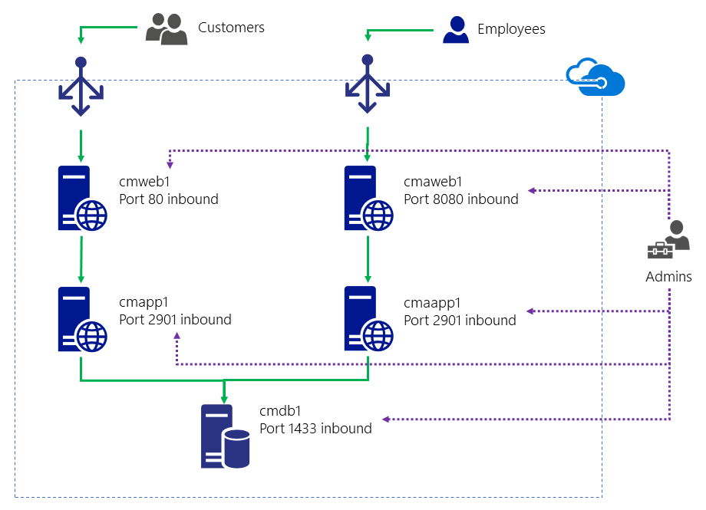
Architecture – Application
Contoso Mortgage (CM)
cmweb1
cmapp1
Contoso Mortgage Admin (CMA)
cmaapp1
cmaweb1
Both
cmdb1
cmad1

Slide 11
Challenge timing guidance
You need to "watch the clock" for your table
Do not pressure your table to move faster if they are behind
Engage your lead coach(es) to discuss strategies for providing additional guidance to your table
Ask them if they have read the links in the Reference section of the challenge
Keep your table on task
For each challenge, encourage them to plan as a team and discuss their plan with your before implementation
After Challenge 1, attendees will always be implementing a solution
You are encouraged to engage your table and make sure they know to check with you prior to implementation in each Challenge

Slide 12
Challenge timing and common strategies to accelerate
Challenge 3
Point out AAD Connect documentation
https://docs.microsoft.com/azure/active-directory/hybrid/how-to-connect-install-express
https://docs.microsoft.com/azure/active-directory/hybrid/how-to-connect-install-custom
Challenge 4
Reminder that only CMAD1 and CMVPN1 need connectivity to Azure
Alter the requirements for AD availability to 99.9% (Single instance VM with Premium disk)
Challenge 5
Migrate only the public web app
Challenge 6
Migrate only the public web app
Point out that files can be copied via FTP
https://docs.microsoft.com/azure/app-service/deploy-ftp
Challenge 8
Migrate only the public web app

Slide 13
For each challenge
Introduce the Challenge and provide your expectations for the table
You may change requirements to accelerate or slow down your table
Encourage your team to plan and verify their plan with you
Reinforce Reference links available for the Challenge
Verify the plan for the Challenge with your table and have them proceed
After your table completes the Challenge, review the Success criteria with them
Remember, you may have changed the criteria when the Challenge started!
As a part of the Challenge retro, make sure you are calling out edge cases and / or differences in how the table solved the Challenge versus how the work would be performed at a customer site or in their own environment
This is a critical step! Do not let your table take away bad habits!

Slide 14
Environment stability
There are several actions attendees can take which will require real-time debugging, or quite often the provisioning of a new environment
If a new environment is not available (e.g. extras were not provisioned as a part of the OpenHack classroom setup), this can impact attendee progress by up to 3 hours
Known actions to avoid
Altering the established routes configured in RAS on cmhost
Altering the established DHCP scopes configured on cmhost
Altering the configuration of existing Hyper-V switches
This includes enabling "external access" on the existing internal switches
Altering the size/series of cmhost
There is a resource lock on the openhackonpremrg resource group, but attendees can remove the lock with existing permissions
There is only one material change required to the host during the execution of the OpenHack
Running the Hyper-V migration appliance pre-req script

Slide 15
Challenge 0 MVP

Slide 16
Challenge 0 MVP
While there is no official Challenge 0 in the attendee guide, there are some things you can do to ensure you'll have a successful and productive hack
Encourage attendees on high DPI Windows devices such as Surface Books to install mRemoteNG to mitigate DPI scaling issues in the native Windows RDP client (note that this is not a requirement for this OpenHack, simply a lifehack)
Have attendees not only read the overview, but also
Login to their Azure subscription and explore the resources that are deployed
Logon to cmhost
Attendees should be very aware that they are working with a "production" environment before they get hands on keyboard

Slide 17
Challenge 1 Establish your plan

Slide 18
Challenge 1 MVP
This challenge is all about planning
Attendees should be targeting people, process, and technology
People
What roles will attendees take on?
What skillsets are at the table?
Process
How are they going to communicate?
How are they going to come to consensus on tooling?
Technology
This is a Microsoft OpenHack - while there are a number of migration tools available, the requirements should be clearly driving them towards Azure Migrate
You may need to reset expectations and guide attendees into the "right" solution set so they will be successful in later challenges!

Slide 19
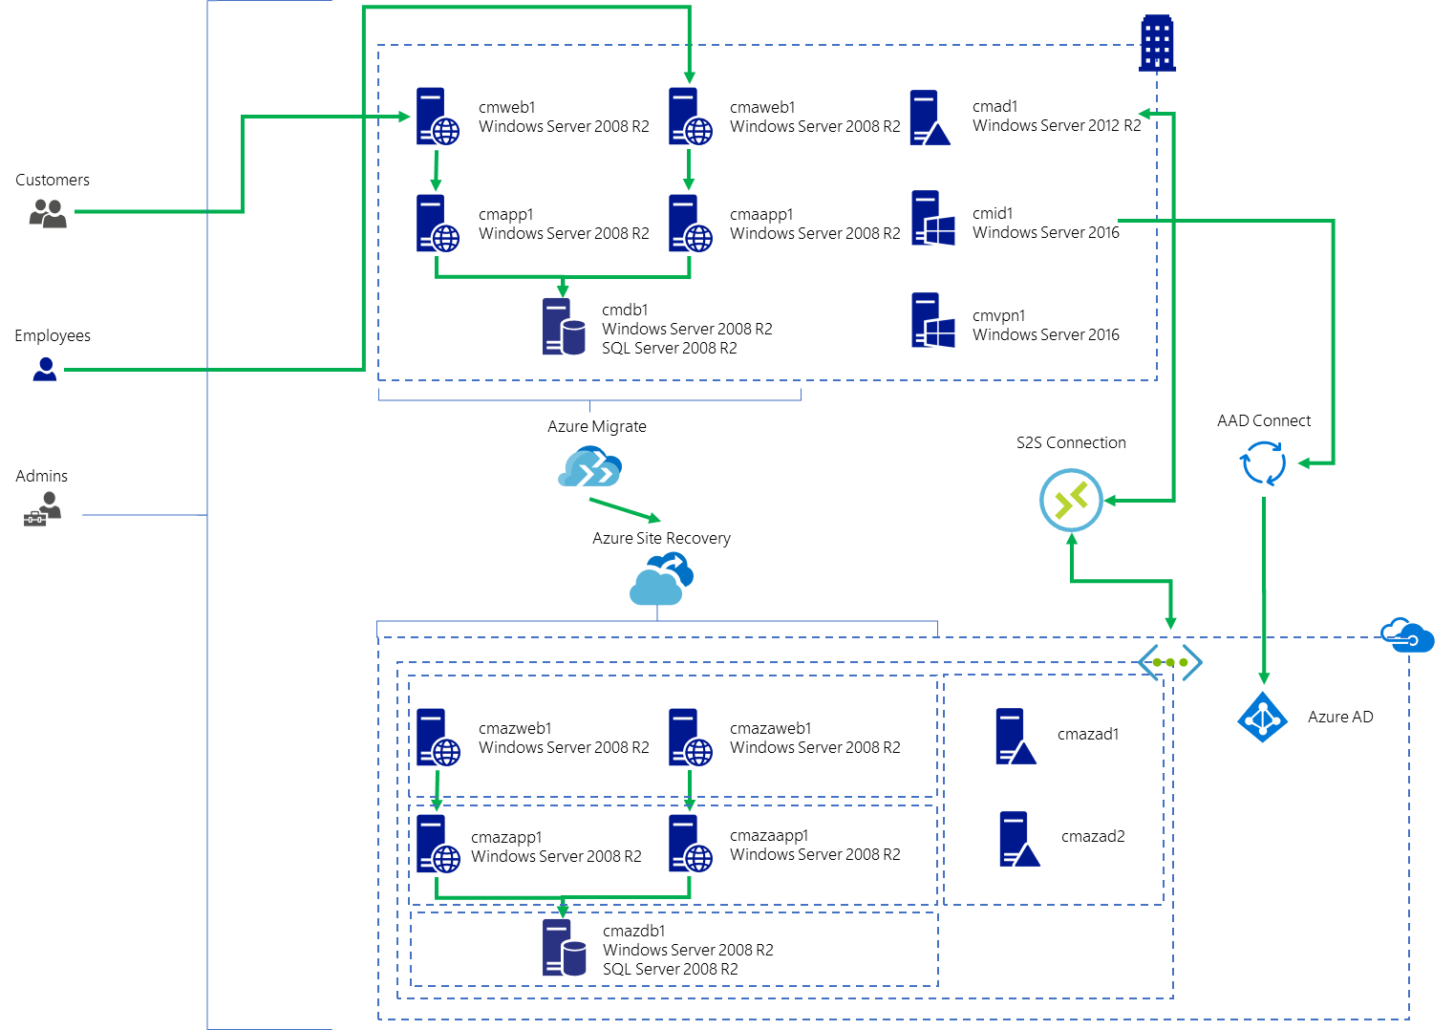
Challenge 1 success criteria
Attendees must present a high-level architecture which shows:
The tools and technologies that will be used to migrate servers to Azure
The tools and technologies that will be used to migrate identities to Azure
The target topology for resources in Azure
Azure Migrate
Azure Database Migration Service
AAD Connect
S2S VPN with DCs in Azure
….

Slide 20
Challenge 1 Responses
What tools or technologies will be used to show server dependencies to Contoso Mortgage?
Dependency visualization through Azure Migrate Server Assessment
https://docs.microsoft.com/azure/migrate/concepts-dependency-visualization
Note: This requires a Log Analytics workspace

Slide 21
Challenge 1 Responses
Prior to migrating any servers to Azure, a cost estimate must be performed. This estimation must be presented under Mortgage’s current pricing offer and their negotiated price with Microsoft. How will you perform this calculation?
Server Assessment will show the current Azure offer for the subscription Azure Migrate is instantiated in and estimates the cost for Compute and Storage based on that offer
https://docs.microsoft.com/azure/migrate/concepts-assessment-calculation
Make sure attendees have determined a solution for the "the rest" (this will require additional tools outside of Azure Migrate such as the Azure Pricing Calculator)
Network
Licensing
Other services

Slide 22
Challenge 1 Responses
What tools or technologies will be used to migrate any existing on-premises identities (users and groups) to Azure?
Azure AD Connect (AAD Connect) is the answer!
This will allow them to synchronize their on-premises identities to Azure and leverage them for Azure RBAC and application identity in later challenges

Slide 23
Challenge 1 Responses
What tools or technologies will be used to allow servers to be domain-joined in Azure and logged on to with existing identities that will be resilient should hybrid connectivity not be available?
One or more DCs will be provisioned in Azure exist as replicas in the existing domain
A S2S connection will need to be provisioned to allow the on-premises DC to replicate to Azure

Slide 24
Challenge 1 Responses
What will be used to allow Contoso to host its public DNS in Azure and manage DNS records for their web applications?
They can use App Service Domains to purchase a domain and manage that domain in Azure DNS
This allows them to create 2 new URLs, and using A and/or CNAME records to direct traffic to the existing applications
They can then point the new URLs to an external load-balancing solution such as Azure Traffic Manager (ATM) or Azure Front Door Service (AFD)
These services will allow clients to connect to the same URL and as applications are migrated, the service can be updated to point to varying backend applications with minimal client interruptions

Slide 25
Challenge 2 Assess workloads for migration

Slide 26
Challenge 2 MVP
This challenge might throw participants off
While it continues the theme of planning, they need to start gathering data from the environment with Azure Migrate or another assessment tool
If they do not use Azure Migrate
This is an unvalidated path, but there are several third-party products which should meet the requirements of the challenge
Allow attendees to implement any tool, however, if it does not meet the specific requirements you may need to guide them to Azure Migrate
If they do use Azure Migrate
This means they need to setup a migration project and deploy the migration appliance!
Before downloading and importing the appliance, they will need to run the Hyper-V preparation script (or perform manual configuration) https://aka.ms/migrate/script/hyperv
When downloading the appliance, they should be download it on the host
Chrome is pre-installed and there is a shortcut on the desktop of the host which can make downloading the appliance much easier

Slide 27
Challenge 2 MVP
The migration appliance is available directly at
https://aka.ms/migrate/appliance/hyperv
When registering the appliance, the internal IP address of the host can be used for discovery
10.0.0.4
Both MMA and the dependency agent need to be installed on all of the relevant servers in on host
cmad1 – 192.168.0.2
cmdb1 – 192.168.0.3
cmaweb1 – 192.168.0.4
cmaapp1 – 192.168.0.5
cmweb1 – 192.168.0.6
cmapp1 – 192.168.0.7
cmid1 – 192.168.0.8
cmvpn1 – 192.168.0.9

Slide 28
Challenge 2 MVP
Timing could be an issue in this challenge
Initial discovery of the VM guests on the host can take up to 15 minutes to appear
Post-MMA/dependency agent installation, it can take up to 15 minutes for telemetry to appear and the status to update in Azure Migrate
The Azure Migrate assessment should
Target the 5 primary servers for the applications
cmaapp1, cmaweb1, cmapp1, cmweb1, and cmdb1
Have a target location that matches the location of the azurevnet in the openhackcloudrg resource group to reflect accurate cost
Use the sizing criterion "As on-premises" (there is not enough time for a performance-based assessment)

Slide 29
Challenge 2 Responses
Where in your assessment can Contoso Mortgage see the dependencies between their existing servers and workloads?
After installing both the MMA and DA agents on the on-premises servers, dependencies can be visualized directly within Azure Migrate
https://docs.microsoft.com/azure/migrate/concepts-dependency-visualization
Where in your assessment can Contoso Mortgage see the estimated cost for each application?
Cost estimates are available directly within the assessment and can be adjusted based on offer
Cost estimates in Azure Migrate do not show external service costs (e.g. network egress, DNS services, etc.) which may require pricing with the Azure Pricing Calculator

Slide 30
Challenge 2 Responses
How does your network design segment the applications targeted for migration and how does it limit communication to required ports and protocols?
Using the provided azurevnet virtual network, new subnets will be created, and each server tier will be migrated into an independent subnet OR
Using the provided azurevnet virtual network, a new subnet will be created, and each server tier will be migrated into the subnet
This is how Azure Migrate and ASR work by default with no customization to the Compute and Network settings of replicated item
https://docs.microsoft.com/azure/site-recovery/site-recovery-manage-network-interfaces-on-premises-to-azure

Slide 31
Challenge 2 Responses
How did you determine the sizing for the servers in Azure?
To get an assessment within the time constraints of the OpenHack, the sizing criterion "As on-premises" was used
In a real environment, given enough time a performance-based assessment is most likely the best option

Slide 32
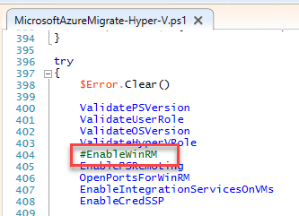
Challenge 2 Known Issues
The host preparation script MicrosoftAzureMigrate-Hyper-V.ps1 may stop responding on the EnableWinRM function if the script is run within the PowerShell ISE
To fix, run once until the script stops responding, end the script, edit the script to comment out the function and run again or just run the script in a regular PowerShell prompt

Slide 33
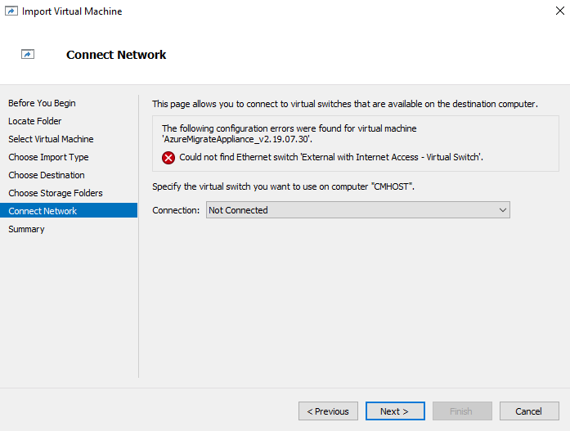

Challenge 2 Known Issues
Importing the migration appliance will present an error on the Connect Network tab of the Import Virtual Machine wizard
If they have used the supplied script in the challenge, they just need to select the InternalMigrateSwitch that was previously provisioned

Slide 34
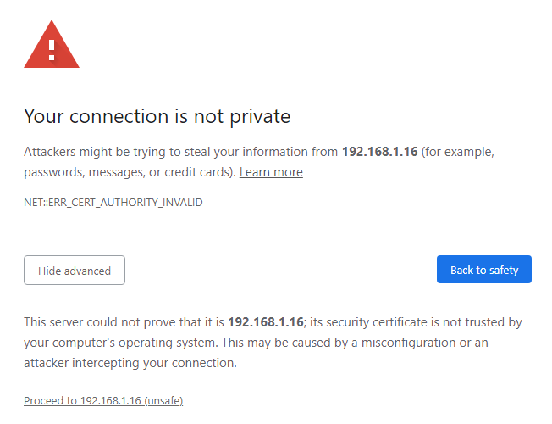
Challenge 2 Known Issues
The migration appliance uses a certificate the host will not trust, and attendees will receive SSL errors (e.g. use untrusted certificate) when connecting from the host

Slide 35
Challenge 2 Cheat Sheet
The existing Hyper-V environment has a NAT network using the IP address space 192.168.0.0/16
The internal NAT switch used by the existing applications uses the subnet 192.168.0.0/24, and each VM in the application has been assigned a static IP address from this subnet.
The migration appliance does not require access to the VM guests, only the host
To allow for this segmentation, a second internal switch has been created on the Hyper-V host called InternalMigrateSwitch which can be used for the migration appliance
This allows the Azure Migrate appliance to pull an IP address from the range 192.168.1.0/24 using the existing host configuration
The switch is not required but will drive closer to a "best-practice" implementation and is called out in the challenge guide
If your table does experience issues with getting the appliance operating on a public switch, this is a known path to get the appliance networked and communicating with the host

Slide 36
Challenge 2 Known Issues
If your table has chosen Azure Migrate for their assessment and the appliance is unable to connect to the host due to WinRM errors
Ensure they have run the configuration script called out in the pre-requisites for Azure Migrate for Hyper-V VMs
https://docs.microsoft.com/en-us/azure/migrate/tutorial-prepare-hyper-v#hyper-v-prerequisites-configuration-script
https://aka.ms/migrate/script/hyperv
On the Migration Appliance
Ensure the appliance VM is attached to the Hyper-V switch InternalMigrateSwitch
Ensure the NIC for the appliance VM is categorized as a Private network connection within the Windows OS of the deployed appliance

Slide 37
Challenge 3 Plan and implement hybrid identity

Slide 38
Challenge 3 MVP
This challenge centers on planning and implementing AAD Connect
Attendees should be focusing on how they will install and configure AAD Connect
They should not be installing AAD Connect yet!
It is recommended they present their plan to you and after you have approved it, they move forward to installing and configuring AAD Connect

Slide 39
Challenge 3 MVP
There is no need to deploy a new server
cmid1 is available and be repurposed for AAD Connect
The server needs to be domain joined
Do not let attendees past the challenge if they have deployed AAD Connect on the domain controller or another server other than cmid1 or one they have created themselves
Only the Azure Users and Azure Security Groups OUs should be synchronized and filtered using one of the following methods
Using Domain and OU filtering
https://docs.microsoft.com/azure/active-directory/hybrid/how-to-connect-install-custom#domain-and-ou-filtering
Or Organizational unit-based filtering
https://docs.microsoft.com/azure/active-directory/hybrid/how-to-connect-sync-configure-filtering#organizational-unitbased-filtering

Slide 40
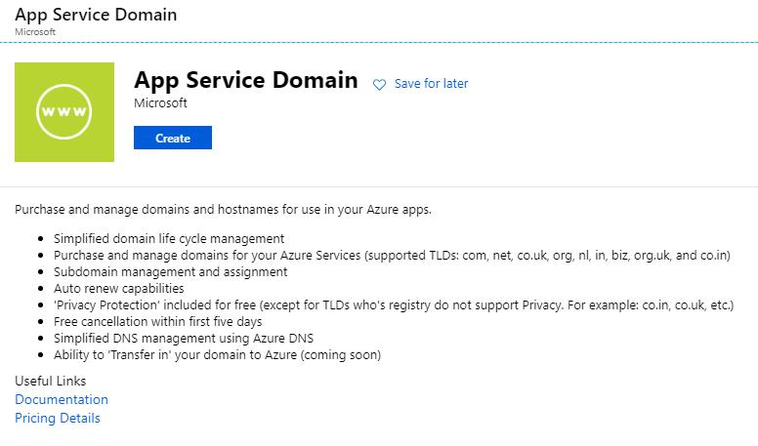
Challenge 3 MVP
Attendees will have access to create and purchase a domain using App Service Domains or bring a domain from another registrar
https://docs.microsoft.com/azure/app-service/manage-custom-dns-buy-domain
The easiest way to do this is to create an App Service Domain resource
This will create only an App Service Domain resource and a DNS Zone resource
There is no requirement and/or need for an App Service Plan currently

Slide 41
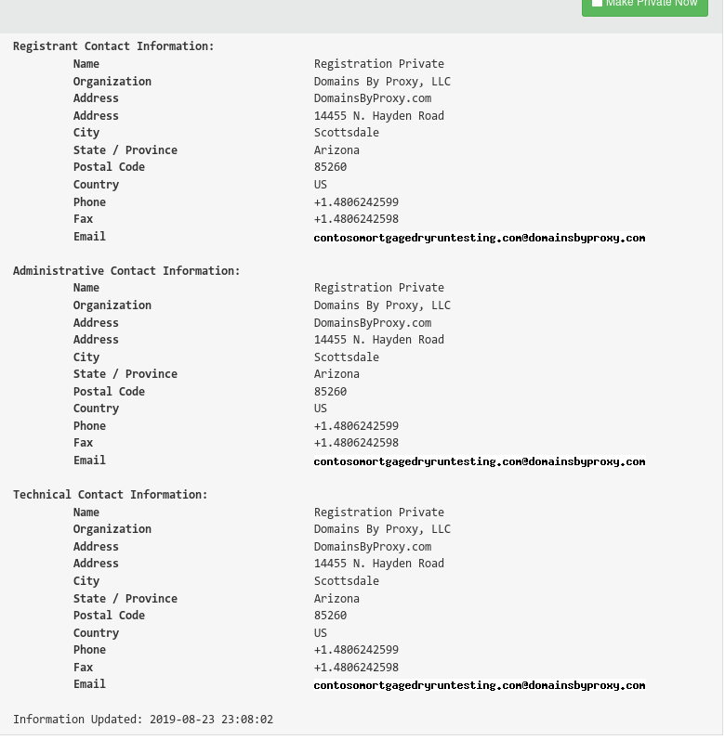
Challenge 3 MVP
When purchasing the domain through App Service Domains, a valid set of contact information needs to be used
This information is registered as private by default with DomainsByProxy

Slide 42
Challenge 3 MVP
The domain they purchase may require changes to the existing Active Directory domain
Add of a UPN suffix
https://docs.microsoft.com/office365/enterprise/prepare-a-non-routable-domain-for-directory-synchronization
Update UPNs for users in the target OUs
See PowerShell on the next slide

Slide 43
Challenge 3 MVP
The domain they purchase may require changes to the existing Active Directory domain
Add of a UPN suffix
https://docs.microsoft.com/office365/enterprise/prepare-a-non-routable-domain-for-directory-synchronization
Update UPNs for users in the target OUs
See PowerShell on the next slide

Slide 44
Challenge 3 MVP Update UPN PowerShell
$domainFilter = "contosomortgage.local"
$targetOU = "CM Users"
$newDomain = "cmfinanceOTAPRD345ops.com"
$targetDN = ""
foreach ($dnPart in $domainFilter.Split(".")) {
$targetDN += "DC=$dnPart,"
}
$targetDN = "OU=$targetOU,$($targetDN.TrimEnd(","))"
$LocalUsers = Get-ADUser -Filter "UserPrincipalName -like '*$($domainFilter)'" `
-SearchBase "$targetDN" `
-Properties userPrincipalName `
-ResultSetSize $null
$LocalUsers | foreach { $newUpn = $_.UserPrincipalName.Replace("$domainFilter","$newDomain"); $_ | Set-ADUser -UserPrincipalName $newUpn }

Slide 45
Challenge 3 Responses
Where will AAD Connect be installed and what rights are required to install and configure AAD Connect?
cmid1 is an available server that meets the requirements for AAD Connect
Global administrator in Azure AD and Enterprise Admin in the local directory
How will you prevent objects outside of the CM Users and CM Security Groups OUs from synchronizing to Azure AD?
Using Domain and OU filtering
https://docs.microsoft.com/azure/active-directory/hybrid/how-to-connect-install-custom#domain-and-ou-filtering
Or Organizational unit-based filtering
https://docs.microsoft.com/azure/active-directory/hybrid/how-to-connect-sync-configure-filtering#organizational-unitbased-filtering

Slide 46
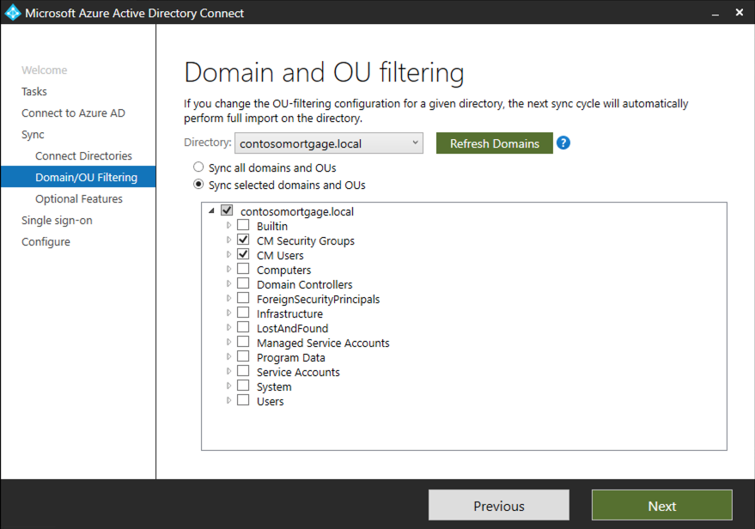
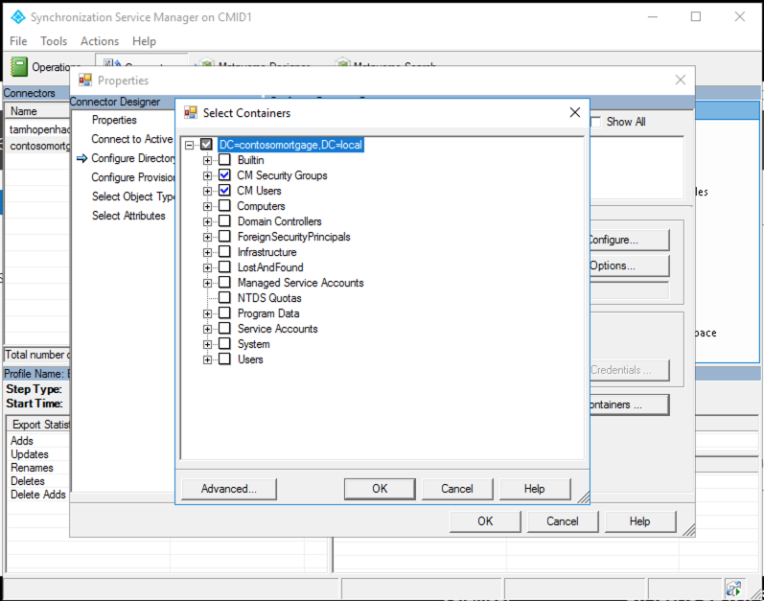
Challenge 3 Responses
How did you configure AAD Connect so that only the CM Users and CM Security Groups OUs were synchronized to Azure AD?

Slide 47
Challenge 3 Responses
Where did you install AAD Connect and what mode did you install it in? Why?
AAD Connect should be installed on cmid1
It should not be running in Staging mode
What domain did you use for verification and how did you ensure users had the correct UPN suffix in place prior to synchronization?
An App Service Domain was created
A custom domain as added to Azure AD and then verified using a TXT or MX record that was created in the DNS zone associated with the provisioned App Service Domain
All the users in the CM Users OU need to have their UPNs updated from username@contosomortgage.local to the new domain suffix
The domain suffix needs to be added to the domain
There are 272 users that require UPN updates

Slide 48
Challenge 3 Responses
How would Contoso Mortgage implement high availability for AAD Connect?
AAD Connect does not have a supported HA topology, however a Staging server can be deployed
https://docs.microsoft.com/azure/active-directory/hybrid/plan-connect-topologies#staging-server
Attendees should be able to explain the purpose of a staging server and how it can be implemented
How will you make sure users can login to Azure with their on-premises credentials while remaining secure?
AAD Connect supports multiple authentication models, including password hash synchronization (PHS) and pass-through authentication (PTA)
https://docs.microsoft.com/azure/active-directory/hybrid/whatis-phs
https://docs.microsoft.com/azure/active-directory/hybrid/how-to-connect-pta
In either case, on-premises identities are synchronized to Azure AD using AAD Connect and UPNs will remain consistent

Slide 49
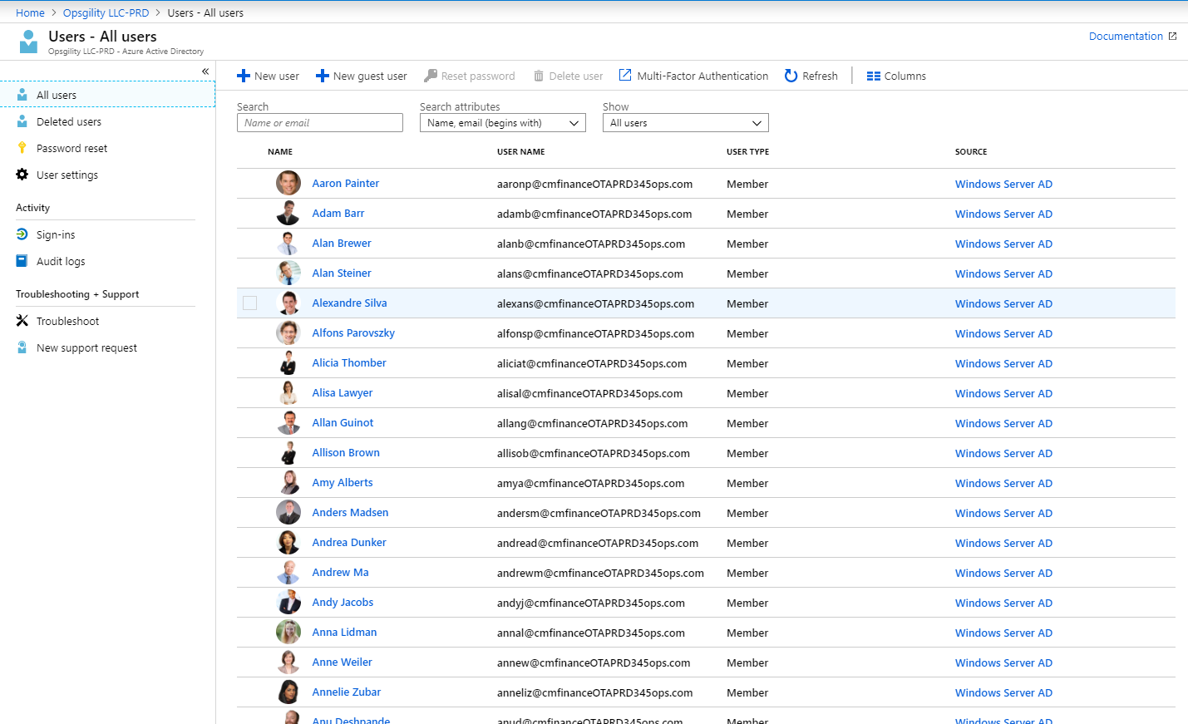
Challenge 3 Final thoughts
After synchronization has completed, users and groups will be visible in Azure AD with a source of Windows Server AD
Do not allow attendees to pass the challenge until the correct OU filtering is in place!

Slide 50
Challenge 4 Implement hybrid networking and resilient authentication

Slide 51
Challenge 4 MVP
There are two goals for this challenge
Complete the hybrid networking configuration
Implement resilient and highly available domain controllers in Azure
There are a number of moving pieces here
Attendees with networking experience should focus on establishing site-to-site connectivity
Attendees without networking experience can being building out servers in Azure, ensuring they are in an Availability Set, etc.

Slide 52
Challenge 4 MVP
One path is to establish the S2S VPN
A Local Network Gateway resource needs to be created in Azure
IP Address will be the public IP address associated with cmhost
The on-premises address range is 192.168.0.0/24
A connection needs to be added to the VPN gateway resource azurevnetvpngateway
RRAS needs to be configured with an on-demand dial connection which points to the azurevnetvpngateway
After connectivity has been established through RRAS, any VMs that require connectivity to Azure through the S2S VPN need to have their network configuration updated
Only cmad1 needs to be updated. The other servers do not require direct access to Azure resources
A set of NAT rules are in place on the host which forward the following ports/protocols to 192.168.0.9
UDP – 500
UDP – 1701
UDP – 4500

Slide 53
Challenge 4 MVP
To establish DC replicas
With the S2S VPN in place, each replica can be joined to the domain if it has been provisioned within the VNET resource azurevnet
The VNET DNS needs to be updated to point to the on-premises DNS server at 192.168.0.2
After the replicas are up and running, the DNS settings for the VNET can be updated to point to the new AD DS servers hosted in Azure
It is a best practice to create a new subnet and site in Active Directory when introducing new AD replicas
A script is provided at https://openhackguides.blob.core.windows.net/guides/microsoft-open-hack-migration/scripts/ADDSCreateSite.ps1 if a table gets stuck
Example usage .\ADDSCreateSite.ps1 -AdSiteName "Contoso-Mortgage-Azure" -ReplicationSubnet "10.1.0.0/16" -Location "Azure"

Slide 54
Challenge 4 MVP ADDSCreateSite.ps1
Param (
[string]$AdSiteName = "New-AD-Site",
[string]$ReplicationSubnet = "10.0.0.0/24",
[string]$Location = ""
)
Import-Module ActiveDirectory
New-ADReplicationSite -Name $adSiteName
New-ADReplicationSubnet -Name $ReplicationSubnet `
-Site $adSiteName `
-Location $Location
New-ADReplicationSiteLink -Name "OnPremises-Azure" `
-SitesIncluded "Default-First-Site-Name",$adSiteName
Set-ADReplicationSiteLink "OnPremises-Azure" `
-Cost 100 `
-ReplicationFrequencyInMinutes 15

Slide 55
Challenge 4 MVP
The new DCs can be joined through a manual dcpromo or through PowerShell
A script is provided at https://openhackguides.blob.core.windows.net/guides/microsoft-open-hack-migration/scripts/ADDSCreateReplica.ps1 if a table gets stuck
Example usage .\ADDSCreateReplica.ps1 -AdSiteName "Contoso-Mortgage-Azure" -DomainName "contosomortgage.local" –ReplicationSourceDc "cmad1.contosomortgage.local" –DomainAdminUserName "CONTOSOMORTGAGE\Administrator" –DomainAdminPassword "demo@pass123"

Slide 56
Challenge 4 MVP ADDSCreateReplica.ps1
Param (
[string]$AdSiteName = "New-AD-Site",
[string]$DomainName = "opsgility.com",
[string]$ReplicationSourceDc = "ad1.opsgility.com",
[string]$DomainAdminUserName = "OPSGILITY\Administrator",
[string]$DomainAdminPassword = "demo@pass123"
)
Install-WindowsFeature -Name AD-Domain-Services -IncludeManagementTools
$securePassword = ConvertTo-SecureString $DomainAdminPassword -AsPlainText -Force
$domaincredential = New-Object System.Management.Automation.PSCredential ($DomainAdminUserName, $securePassword)
Install-ADDSDomainController -CreateDnsDelegation:$false `
-Credential $domaincredential `
-DatabasePath 'F:\Windows\NTDS' `
-SysvolPath 'F:\Windows\SYSVOL' `
-LogPath 'F:\Windows\NTDS' `
-DomainName $DomainName `
-InstallDns:$true `
-SiteName $AdSiteName `
-ReplicationSourceDC $ReplicationSourceDc `
-NoGlobalCatalog:$false `
-NoRebootOnCompletion:$true `
-Force:$true `
-SafeModeAdministratorPassword $securePassword

Slide 57
Challenge 4 Known issues
The VPN Gateway in Azure will not connect sometimes
Troubleshooting: An Azure site-to-site VPN connection cannot connect and stops working
Reset a VPN Gateway

Slide 58
Challenge 4 Known Issues
After site-to-site connectivity has been established, on-premises machines will need to have their IP configuration updated to use the server cmvpn1 for their gateway to route traffic to Azure
The script on the following slide can be used to set the IP address of an on-premises VM in the address range 192.168.0.0/24 to use the IP address of cmvpn1 (192.168.0.9) for its gateway
This allows it to send traffic to Azure through the RRAS server and allowing the RRAS server to route traffic to the on-premises VM
The easiest path is to avoid NIC configuration and use a forced route on cmad1 route -p add 10.1.0.0 mask 255.255.0.0 192.168.0.9

Slide 59
Set Gateway and DNS PowerShell
get-wmiobject win32_networkadapterconfiguration | ? { $_.IPAddress -ne $null } | Sort-Object IPAddress -Unique | % {
$CurrentIPs+=$_.IPAddress
}
$CurrentIpV4IP = ""
foreach ($ip in $CurrentIPs) {
if ($ip.ToString() -like "192.168.0.*") {
$CurrentIpV4IP = $ip.ToString()
}
}
$CurrentIpV4IP
$interface = get-wmiobject win32_networkadapter | select netconnectionid | ? { $_.netconnectionid.length -gt 0 }
netsh interface ip set address "$($interface.netconnectionid)" static $CurrentIpV4IP 255.255.255.0 192.168.0.9
netsh interface ip add dns "$($interface.netconnectionid)" 192.168.0.2

Slide 60
Challenge 5 Test migration

Slide 61
Challenge 5 MVP
The theme of this challenge is isolated testing
Timing will be an issue with this challenge!
Resources provisioned in this challenge can take several hours to provision
VM replication
….
To be successful, a number of pieces of infrastructure will need to be created
Virtual Network for testing
Azure Bastion host for RDP access
Note that Azure Bastion is not required to complete this Challenge
…

Slide 62
Challenge 5 MVP
Initial replication can take up to 1 hour – be prepared to guide your table into other tasks such as
Creating any surround infrastructure such as load balancers
Exploring the Recovery Services Vault associated with the Azure Migrate project

Slide 63
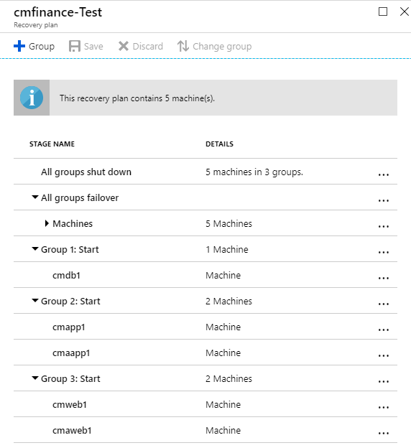
Challenge 5 MVP
To orchestrate test failover
(vs manually initiating test failover for individual machines),
a Recovery plan will need to be manually created directly in the Recovery services vault

Slide 64
Challenge 5 MVP
On test failover, it is acceptable to use the production VNET
This is a one-way migration and it will shorten testing iteration
Call out that a test VNET may be preferable in other situations
Each target replicated item's Compute and Network settings should be updated to use a static IP
This makes DNS in the managed domain easier as the applications are reconfigured (e.g. web.config modifications)
Creating an Azure Bastion Host
Requires access the preview feature through an aka.ms URL
https://aka.ms/BastionHost
Requires a subnet with at least a /27 range named AzureBastionSubnet
It takes ~5 minutes for the resource to create

Slide 65
Challenge 5 MVP
After the failover, the VMs are going to overwrite DNS records on the on-premises AD and break the application
Servers will need to be renamed in Azure, and on-premises servers will need to be rebooted to bring the DNS records back inline unless the S2S connection is brought down first
After the failover, the Azure Windows VM Agent should be installed
This allows the fabric controller to install extensions and perform post-deployment configuration of the VMs
https://docs.microsoft.com/azure/virtual-machines/extensions/agent-windows#manual-installation
In some cases, the VM Agent may need to be installed prior to failover, but this is not recommended
See Slide Notes for Feedback about contradiction.
Notes:
FEEDBACK: Above "After the failover, the Azure Windows VM Agent should be installed" and "In some cases, the VM Agent may need to be installed prior to failover, but this is not recommended" contradicts the documentation originally directed to as part of Challenge 2, in particular:
Prepare for Hyper-V Migration (which directs you to https://docs.microsoft.com/en-ca/azure/migrate/prepare-for-migration#windows-machines)
Connect after migration (https://docs.microsoft.com/en-ca/azure/migrate/prepare-for-migration#prepare-to-connect-to-azure-windows-vms )
Required Services (https://docs.microsoft.com/en-ca/azure/virtual-machines/windows/prepare-for-upload-vhd-image#check-the-windows-services )
Complete the recommended configurations (https://docs.microsoft.com/en-ca/azure/virtual-machines/windows/prepare-for-upload-vhd-image#complete-the-recommended-configurations )

Slide 66
Challenge 5 MVP
After the test servers are accessible (e.g. via RDP), they will need post-configuration
Each server needs to be renamed and joined to the existing domain
cmdb1
The disks (F and L) need to be brought online (e.g. through Disk Management)
The service accounts for SQL Server will need to be recreated and reset
Each application needs configuration updates
cmaapp1
Update C:\inetpub\wwwroot\web.config to point to cmdb1 if the server name was changed
cmapp1
Update C:\inetpub\wwwroot\web.config to point to cmdb1 if the server name was changed
cmaweb1
Update C:\inetpub\wwwroot\web.config to point to cmaapp1 or an updated FQDN for adminapi.contosomortgage.local
cmweb1
Update C:\inetpub\wwwroot\web.config to point to cmapp1 or an updated FQDN api.contosomortgage.local

Slide 67
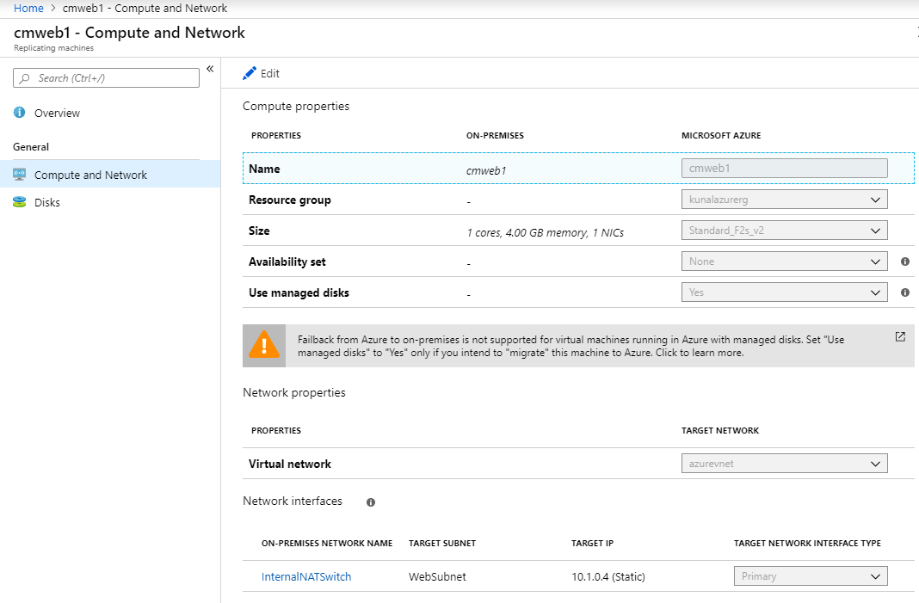
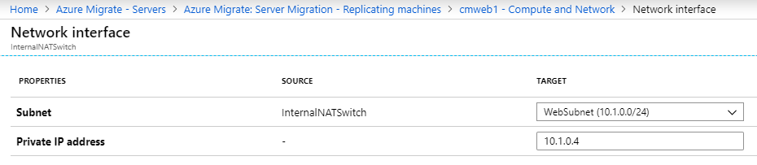
Challenge 5 Responses
How did you maintain network segmentation for the migrated applications, including constraining the available ports and protocols between application layers?
As Azure Migrate replicates into a single VNET and Subnet with no customization, NSGs applied to the NICs directly were used to segment ports and protocols
In the future, the VMs could be moved into dedicated subnets and extended with ASGs
OR
The Compute and Network settings can be customized to target pre-created subnets within the target VNET
https://docs.microsoft.com/azure/site-recovery/site-recovery-manage-network-interfaces-on-premises-to-azure

Slide 68
Challenge 5 Responses
What is the method you used to provide a URL to testers?
Two new A records (or CNAMEs) were created in the Azure DNS zone created in Challenge 4
The records were configured to point to the public IPs for cmweb1 and cmaweb1
The URLs were distributed to testers

Slide 69
Challenge 5 Responses
How did you allow server administrators to connect to the servers without opening RDP access to the internet?
An Azure Bastion Host was provisioned, and access was granted to the appropriate users
How are server administrators able to use their on-premises credentials to access the servers in Azure without hybrid connectivity to their on-premises domain controllers in place?
The existing synchronized DC replicas will service authentication requests even when the S2S VPN is down
The migrated VMs where manually renamed and joined to the domain prior to distributing connection information

Slide 70
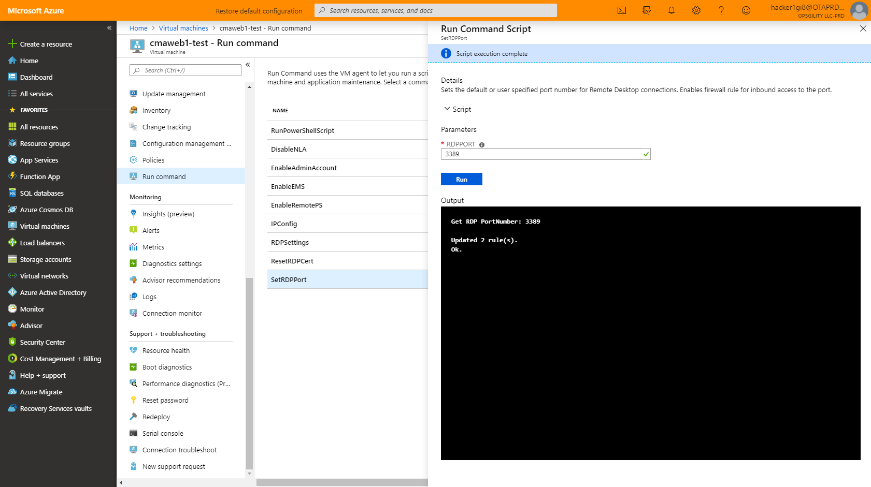
Challenge 5 Known Issues
Server 2008 and 2008 R2 VMs can be unavailable for RDP after a failover
A reboot or deploy can sometimes fix this
If it does not, you will need to debug the connectivity in Azure
If the VM had the VM guest agent installed prior to failover, you can use the Run command blade to reset RDP settings

Slide 71
Challenge 5 Known Issues
If Azure Bastion is used
The Azure Bastion host will appear to provision; however the resource will have a Provisioning state of Failed
The template can be redeployed
Attendees can provision a jump box in the same VNet as their migrated machines to move forward
Azure Bastion is a preview service and carries no SLA
It is not worth fighting it in the even they can move on another way

Slide 72
Challenge 5 Final thoughts
Make sure that your table cleans any existing resources that may impact the final migration
Clean up test failovers
Reconfigure or delete load balancers
Note that they can absolutely keep the existing load balancers
Delete DNS records

Slide 73
Challenge 6 Finalize migration

Slide 74
Challenge 6 MVP
At the conclusion, attendees will have executed an end-to-end migration using a rehost methodology
This challenge can feel like a repeat of Challenge 5, but it is important to understand the migration cycle of
Assess
Test
Migrate
Optimize
New infrastructure will be introduced that was not present in Challenge 5
Azure Traffic Manager (ATM), Azure Front Door Service (AFD), or App Gateway as a single endpoint that will let clients be directed to the on-premises implementation or the new cloud-hosted infrastructure

Slide 75
Challenge 6 MVP
From the time a table starts the migration, they have one hour to complete the full migration
This does not mean they only have one hour for the challenge; this is just from when they start the VM migration in Azure Migrate
Pre-staging other infrastructure is critical
Load balancers
Traffic Manager, …
NSGs
This is an accomplishable goal with teamwork!
Each hacker onboarding a VM
Hacker1 onboards cmdb1
Hacker2 onboards cmapp1
Hacker 3 onboards cmaweb1
…

Slide 76
Challenge 6 Responses
What is the method you used to use the same URL in Azure that was used on-premises for each application?
A pair of new DNS CNAME records were created for the www and admin sites (e.g. www.cmfinance.com and admin.cmfinance.com)
A Traffic Manager profile was created for each site (e.g. tmwww.trafficmanager.net and tmadmin.trafficmanager.net)
Endpoints were configured for both the on-premises and cloud environments
The URLs were distributed to consumers before the migration started
When the on-premises VMs were shut down the service entered a degraded state
When the cloud VMs came online the service entered an online state
How does this solution allow for quick failover to on-premises in the event an error occurs during the migration?
Using Priority weighting in Traffic Manager, traffic can be directly to only the Online endpoint with the highest priority
If the migration fails, the on-premises VMs just need to be powered back on

Slide 77
Challenge 6 Known Issues
Traffic Manager endpoint probes will fail for IWA authenticated sites such as the admin site
TM requires an anonymously authenticated endpoint to have an endpoint come Online
https://blogs.msdn.microsoft.com/jpsanders/2017/02/06/azure-traffic-manager-probe-degraded-due-to-401-from-azure-web-app/

Slide 78
Challenge 6 Final thoughts
After the migration of the VMs is complete and tested, do not forget to finalize the migration
Stop replication for the VMs in Azure Migrate
Potentially backup/archive on-premises virtual machines that have been migrated

Slide 79
Challenge 7 Transition to platform database services

Slide 80
Challenge 7 MVP
This challenge centers on the migration of the existing databases currently hosted on cmdb1 to Azure SQL Database
At this point, cmdb1 should be the IaaS server that was migrated in Challenge 6
There are two databases that need to migrate, but not necessarily at the same time
contosomortgagedb
contosomortgageidentity
Managed Instance is not required for this challenge and is overkill
The source database are very small
An S0 or S1 Azure SQL Database with a 1 GB quota will be more than enough compute and storage
Azure Migrate can be used as a launch point of Azure Database Migration Service and greatly simplifies the migration process for assessment and migration (if it works – see Known Issues)

Slide 81
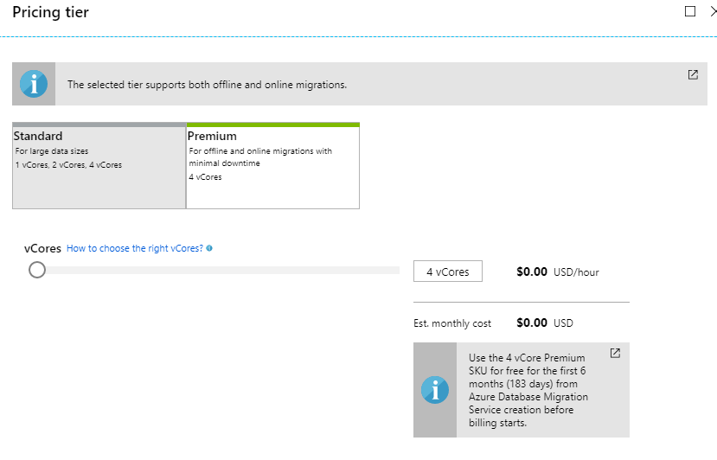
Challenge 7 MVP
When creating the DMS service instance, the existing virtual network azurevnet can be used
The migrated VMs should already exist in this VNet
Even with a minimal size, a Premium pricing tier is required for ADMS to have access to online migrations

Slide 82
Challenge 7 MVP
If online migrations are desired (up to the table), additional configuration of the source server will be required
https://docs.microsoft.com/sql/relational-databases/replication/configure-publishing-and-distribution

Slide 83
Challenge 6 Responses
What is the method you used to use the same URL in Azure that was used on-premises for each application?
A pair of new DNS CNAME records were created for the www and admin sites (e.g. www.cmfinance.com and admin.cmfinance.com)
A Traffic Manager profile was created for each site (e.g. tmwww.trafficmanager.net and tmadmin.trafficmanager.net)
Endpoints were configured for both the on-premises and cloud environments
The URLs were distributed to consumers before the migration started
When the on-premises VMs were shut down the service entered a degraded state
When the cloud VMs came online the service entered an online state
How does this solution allow for quick failover to on-premises in the event an error occurs during the migration?
Using Priority weighting in Traffic Manager, traffic can be directly to only the Online endpoint with the highest priority
If the migration fails, the on-premises VMs just need to be powered back on

Slide 84
Challenge 6 Known Issues
Traffic Manager endpoint probes will fail for IWA authenticated sites such as the admin site
TM requires an anonymously authenticated endpoint to have an endpoint come Online
https://blogs.msdn.microsoft.com/jpsanders/2017/02/06/azure-traffic-manager-probe-degraded-due-to-401-from-azure-web-app/

Slide 85
Challenge 6 Final Thoughts
After the migration of the VMs is complete and tested, do not forget to finalize the migration
Stop replication for the VMs in Azure Migrate
Potentially backup/archive on-premises virtual machines that have been migrated

Slide 86
Challenge 7
Transition to platform database services

Slide 87
Challenge 7 MVP
This challenge centers on the migration of the existing databases currently hosted on cmdb1 to Azure SQL Database
At this point, cmdb1 should be the IaaS server that was migrated in Challenge 6
There are two databases that need to migrate, but not necessarily at the same time
contosomortgagedb
contosomortgageidentity
Managed Instance is not required for this challenge and is overkill
The source database are very small
An S0 or S1 Azure SQL Database with a 1 GB quota will be more than enough compute and storage
Azure Migrate can be used as a launch point of Azure Database Migration Service and greatly simplifies the migration process for assessment and migration (if it works – see Known Issues)

Slide 88
Challenge 7 MVP
When creating the DMS service instance, the existing virtual network azurevnet can be used
The migrated VMs should already exist in this VNet
Even with a minimal size, a Premium pricing tier is required for ADMS to have access to online migrations

Slide 89
Challenge 7 MVP
If online migrations are desired (up to the table), additional configuration of the source server will be required
https://docs.microsoft.com/sql/relational-databases/replication/configure-publishing-and-distribution

Slide 90
Challenge 7 Responses
How did you determine the compatibility of the existing databases with Azure SQL Database?
The Database Migration Assistant was used in combination with an assessment uploaded to Azure Migration and the Azure Database Migration Service
The assessment called out no combability issues for either of the two source databases prior to migration
How did you determine the performance tier for Azure SQL Database?
The size of the on-premises databases was evaluated and the existing throughput on the server was deemed to be low
What tools did you use to assess the databases for Azure readiness and migrate the databases to Azure SQL?
Database Migration Assistant
Azure Migrate
Azure Database Migration Service

Slide 91
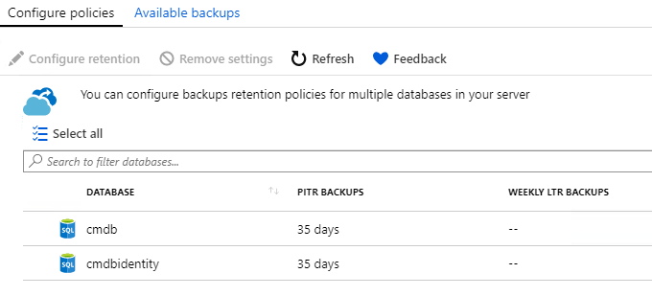
Challenge 7 Responses
How are you ensuring the retention of backups meets Contoso Mortgage's requirements?
The backup retention for each database was changed from the default of 7 days to 30 days or greater
https://docs.microsoft.com/azure/sql-database/sql-database-automated-backups#how-long-are-backups-kept

Slide 92
Challenge 7 Responses
What configuration changes did you have to make the API tier of the web applications to use and secure Azure SQL Database?
The web.config file for each site was updated to point to the new Azure SQL Databases
A service endpoint was configured on the subnet which contains the migrated application server VMs to route traffic directly to Azure SQL
The Azure SQL Database Server firewall was configured to only allow traffic from the subnet(s) containing the API tier endpoints
This configuration will work with Allow access to Azure services set to Off

Slide 93
Challenge 7 Responses
How did you configure RBAC for the services?
The CM Server Admins security group has been granted the following on the server resource
Either Contributor rights or a combination of
SQL Security Manager
SQL Server Contributor
SQL DB Contributor
The CM Database Admins security group has been granted the following on the server resource
SQL DB Contributor

Slide 94
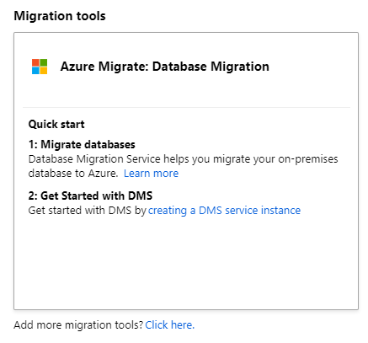
Challenge 7 Known Errors
When trying to create a DMS service instance through the Databases blade of Azure Migrate, the deployment may not submit
If this happens, a DMS service instance can be created through the normal service creation path but it will not be associated with Azure Migrate

Slide 95
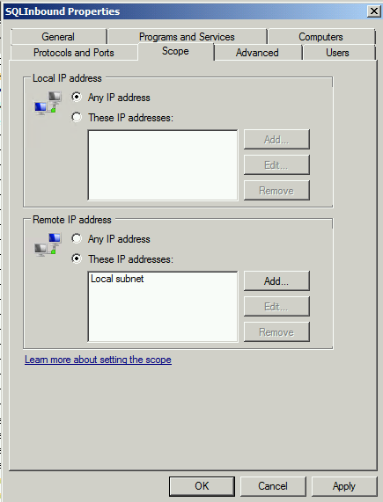
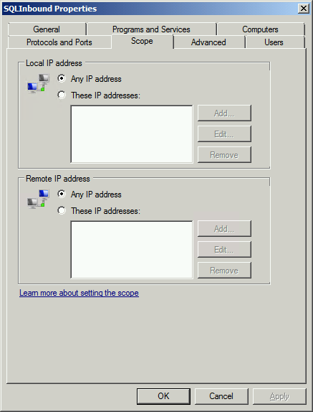
Challenge 7 Known Issues
The DMS service instance is unable to connect to the source database
This is because of a firewall rule on cmdb1 which in its current configuration only allows connections from the local subnet

Slide 96
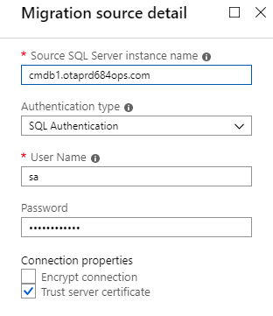
Challenge 7 Known Issues
The DMS service instance is unable to connect to the source database
If the firewall has been ruled out, it may be resolution to the database
AAD DS as the DNS provider for the VNet requires FQDNs to be used
Rather than cmdb1, use the FQDN of the server in the AAD DS domain

Slide 97
Challenge 7 Known Issues
When migrating the database schemas for contosomortgagedb and contosomortgageidentity it is possible to create the login for the existing financeUser but the user needs to be enabled by logging in to the Azure SQL server and running ALTER statements against the user

Slide 98
Challenge 7 Known Issues ALTER Statement
ALTER LOGIN financeUser ENABLE;
ALTER LOGIN financeUser WITH PASSWORD = 'financeAdmin001!';

Slide 99
Challenge 7 Final thoughts
Make sure that your table cleans any existing resources that are no longer needed
cmdb1 can be stopped/deleted
Azure Database Migration Service can be deleted

Slide 100
Challenge 8 Transition to platform web-hosting services

Slide 101
Challenge 8 MVP
This challenge centers on migrating the IaaS-hosted web applications to a PaaS web-hosting service
Azure App Service
App Service for Containers
Containers
There are many paths that will work to get the web apps over to PaaS
Focus on the outcomes, not how the table gets there
When sizing the App Service plan, an S1 SKU is the smallest acceptable SKU
This is a production workload
It requires custom domains and SSL

Slide 102
Challenge 8 Responses
How did you implement SSL for each website?
Regardless of where the cert is purchased from, each front-end web app (see Known Issues) should be accessible over only SSL
If the certificate is provisioned in Azure, a wildcard cert will cover both domains
This is configured in the TLS/SSL settings blade of the App Service

Slide 103
Challenge 8 Responses
What was your approach to migrating the existing sites from IaaS to Azure App Service?
It is possible to copy the raw code (e.g. use FTP to copy the files) and update the web.config settings as required)
If using FTP, use a client such as FileZilla to make connections easier
Its best to be methodical in the approach
Get the API web app working
Web the front-end web app working
Apply SSL
Bring behind Traffic Manager or Front Door

Slide 104
Challenge 8 Responses
How did you maintain the URL for each application during and after the migration?
If Traffic Manager or Front Door were used earlier, they can continue to be repurposed here
If Traffic Manager was used
The probe will need to be configured to point to port 80 as port 8080 will not be a valid configuration in Azure App Service

Slide 105
Challenge 8 Responses
How will Contoso Mortgage be able to break down the cost for each website independently?
As an App Service plan is billing unit for Azure App Service and Web Apps, for each workload (Contoso Mortgage and Contoso Mortgage Admin)
An App Service Plan needs to be created
One (or both) of the web apps associated with the workload will leverage the App Service plan

Slide 106
Challenge 8 Responses
How did you configure the Contoso Mortgage Admin site to require authentication?
Azure AD Authentication can be easily enabled
It is not possible without an Azure AD P1 or P2 plan to perform group-based licensing
With the proper license
A dynamic security group could be created which contains only the members of the Sales department
That security group could then be used to constrain access to the application
Enabling Azure AD authN will break any probes from Traffic Manager or Front Door
The same method (and probe that was created) in Challenge 6 can be used to overcome this
https://blogs.msdn.microsoft.com/jpsanders/2017/02/06/azure-traffic-manager-probe-degraded-due-to-401-from-azure-web-app/
https://azure.github.io/AppService/2016/11/17/URL-Authorization-Rules.html

Slide 107
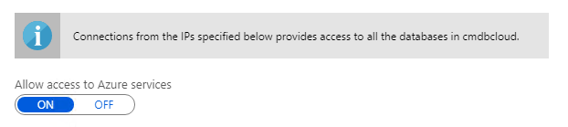
Challenge 8 Known Issues
If Challenge 7 has been completed first, in the Azure SQL Database server settings, the firewall may not be configured to allow connections from Azure services
Ensure Allow access to Azure services is On or the API web apps will not be able to connect to the database(s)

Slide 108
Challenge 8 Known Issues
The AppSettings key ApiBaseUrl in the web.config for the front-end web apps cannot parse https URLs
The value must be an http URL and not https

Slide 109
Challenge 9 Secure, optimize, and operate

Slide 110
Challenge 9 MVP
This challenge is all about the little things and extra features that can be enabled after a migration to provide
Insights into performance
Better security for application secrets and connection strings
Increased performance when needed with horizontal and elastic scaling
Implementing Azure Service and Resource Health monitoring

Slide 111
Challenge 9 Responses
What configuration did you implement to allow for horizontal scale in their websites?
Scale out has been configured on each App Service (4 total)
Make sure your table explorers both Manual scale and Custom autoscale rules and can explain the difference between them
Have your table create at least one Custom autoscale rule based on a metric

Slide 112
Challenge 9 Responses
What did you configure to allow members of the CM Operations security group to see the real-time performance of each website?
Application Insights has been enabled for all the websites (4)
The CM Operations security group has a role assignment of Reader applied to each Application Insights resource

Slide 113
Challenge 9 Responses
How did you secure the application configuration and database connection strings for each website?
A Key Vault has been provisioned to store app settings and connection strings
It is acceptable to reuse the existing vault that was created in Challenge 8 when configuring App Service SSL if applicable
A system assigned identity has been created for each App Service Web App
https://docs.microsoft.com/azure/app-service/overview-managed-identity
An access policy has been created in the vault granting the system assigned identity access to the appropriate secrets
https://docs.microsoft.com/azure/key-vault/key-vault-secure-your-key-vault#key-vault-access-policies
The application has been configured to source the secret from the vault
https://docs.microsoft.com/azure/app-service/app-service-key-vault-references#source-application-settings-from-key-vault
Access to the vault has been restricted to the required VNets and allows trusted Microsoft services to bypass the firewall

Slide 114
Challenge 9 Responses
How did you ensure the databases are encrypted at rest?
TDE has been implemented with customer managed key (CMK)
https://docs.microsoft.com/azure/sql-database/transparent-data-encryption-byok-azure-sql
https://docs.microsoft.com/azure/sql-database/transparent-data-encryption-byok-azure-sql-configure
Key Vault (AKV) soft-delete is required and cannot be enabled through the portal at this time
https://docs.microsoft.com/azure/key-vault/key-vault-soft-delete-powershell#enabling-soft-delete
A resource lock should be set on the AKV
This is a critical step that your table may miss!
TDE is enabled by default with a Microsoft managed key
This means TDE needs to be disabled then re-enabled using the AKV key
It is not enough to just see if TDE is on, you need to inspect the vault and the settings of the logical SQL server Get-AzSqlServerKeyVaultKey ` -ServerName <LogicalServerName> ` -ResourceGroupName <SQLDatabaseResourceGroupName>

Slide 115
Challenge 9 MVP Database Encryption
$sqldbrg = "clouddbrg"
$sqlserver = "clouddb"
$vault = "cloudvault"
# Assign managed identity
$server = Set-AzSqlServer `
-ResourceGroupName $sqldbrg `
-ServerName $sqlserver `
-AssignIdentity
# Grant AKV permissions to identity
Set-AzKeyVaultAccessPolicy `
-VaultName $vault `
-ObjectId $server.Identity.PrincipalId `
-PermissionsToKeys get, wrapKey, unwrapKey

Slide 116
Challenge 9 MVP Database Encryption
$sqldbrg = "clouddbrg"
$sqlserver = "clouddb"
$vault = "cloudvault"
# Assign managed identity
$server = Set-AzSqlServer `
-ResourceGroupName $sqldbrg `
-ServerName $sqlserver `
-AssignIdentity
# Grant AKV permissions to identity
Set-AzKeyVaultAccessPolicy `
-VaultName $vault `
-ObjectId $server.Identity.PrincipalId `
-PermissionsToKeys get, wrapKey, unwrapKey

Slide 117
Challenge 9 MVP Database Encryption
$databases = @("clouddb", "clouddbidentity")
# Disable existing Microsoft managed key
foreach ($database in $databases) {
Set-AzSqlDatabaseTransparentDataEncryption `
-ResourceGroupName $sqldbrg `
-ServerName $sqlserver `
-DatabaseName $database`
-State "Disabled"
}
# Wait a few minutes for encryption to disable and logs to commit
# (yes, this could be much more resilient)
Start-Sleep –Seconds 120
# Enable with the new key
foreach ($database in $databases) {
Set-AzSqlDatabaseTransparentDataEncryption `
-ResourceGroupName $sqldbrg `
-ServerName $sqlserver `
-DatabaseName $database `
-State "Enabled"
}

Slide 118
Challenge 9 MVP Database Encryption
# Get the encryption state
foreach ($database in $databases) {
Get-AzSqlDatabaseTransparentDataEncryption `
-ResourceGroupName $sqldbrg `
-ServerName $sqlserver `
-DatabaseName $database `
}

Slide 119
Coach solutions folder
https://aka.ms/OHCoachMaterials/Migration

Slide 120
Thank you coaches!

